Slide 1

HEALTHCARE
Hospital Management System
Presented by: Tanya Mistry, Krishang Shah [DS5110]

Slide 2
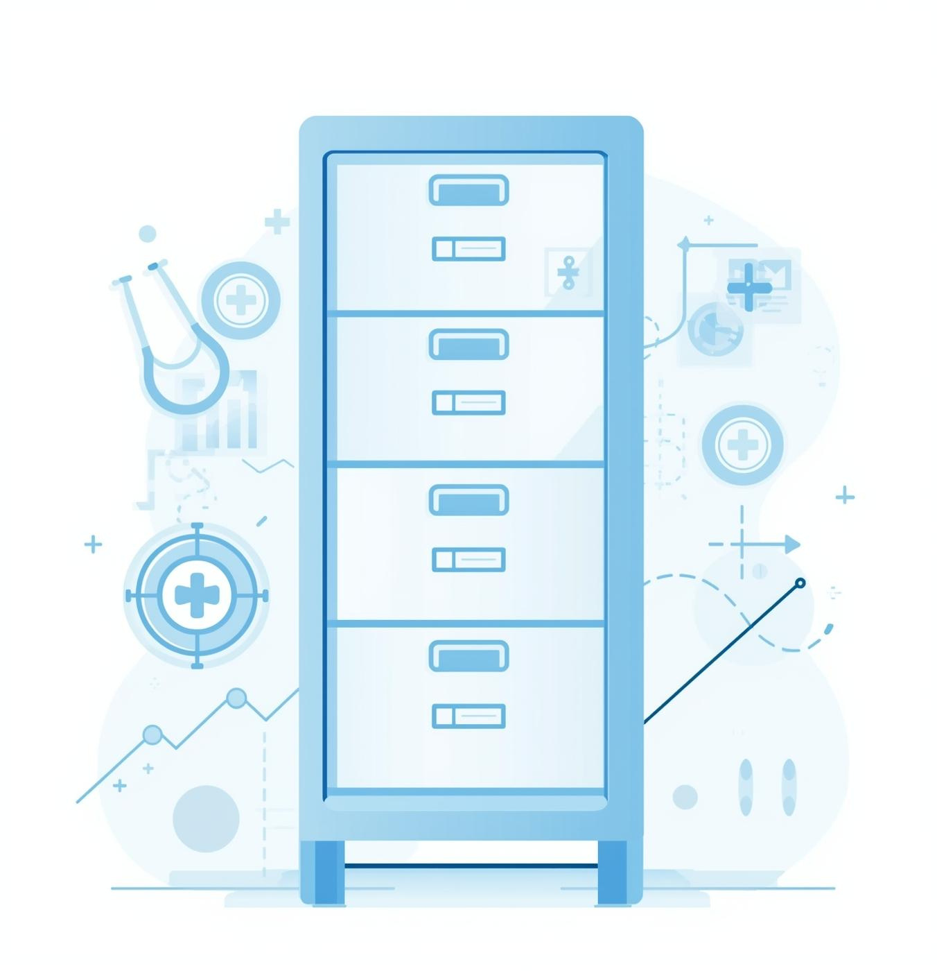
The Need for Change
Hospitals face significant challenges due to fragmented paper records and inconsistent data. Slow access to information hampers decision-making, leading to poor analytics and ultimately impacting patient care. A modernized system is essential for improved efficiency and data management.

Slide 3
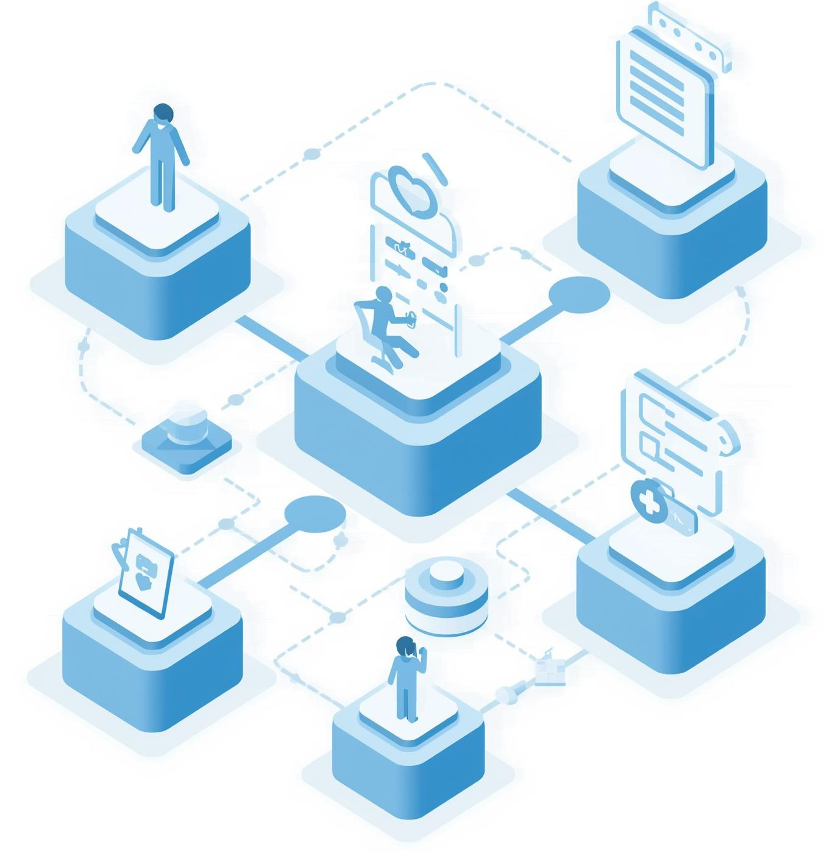
Our Unified Solution
The Unified Hospital Admin System is an innovative prototype designed exclusively for administrative use. It features clean workflows, secure data management, and a modular architecture, providing a comprehensive platform for managing hospital operations efficiently and effectively.

Slide 4
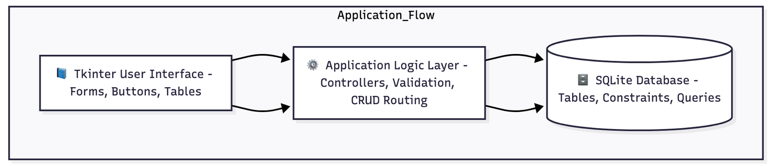
Technical Architecture
The architecture of our hospital management system features a robust Tkinter front-end for user interaction and an SQLite backend for efficient data storage. This layered design enhances data flow, ensuring seamless integration and improved user experience across various modules.

Slide 5
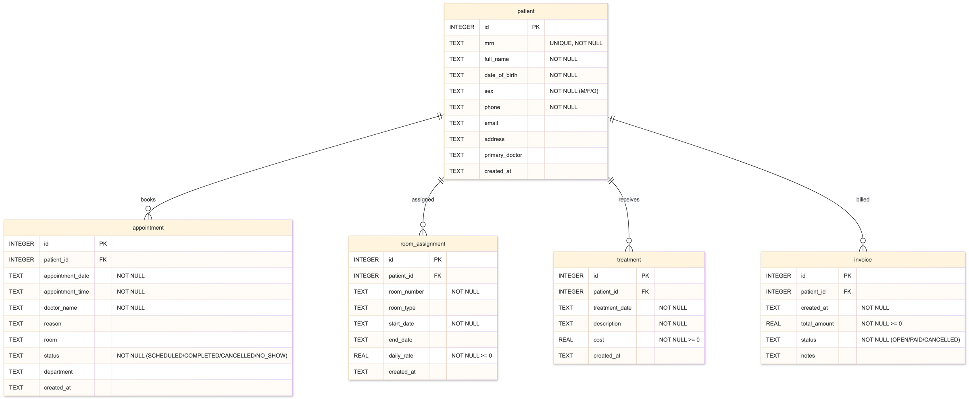

Entity-Relationship Diagram

Slide 6
Key Technical Features
Foreign Keys
CHECK Constraints
Employing foreign keys ensures data integrity across the database, enabling seamless relationships between tables.
CHECK constraints validate data entries, ensuring only acceptable values are stored in the database fields.
Indexing
Seeded Data
Indexing enhances data retrieval speed, significantly improving performance for database queries and user interactions.
Seeded data allows for initial testing and development, providing realistic sample records for the application.

Slide 7
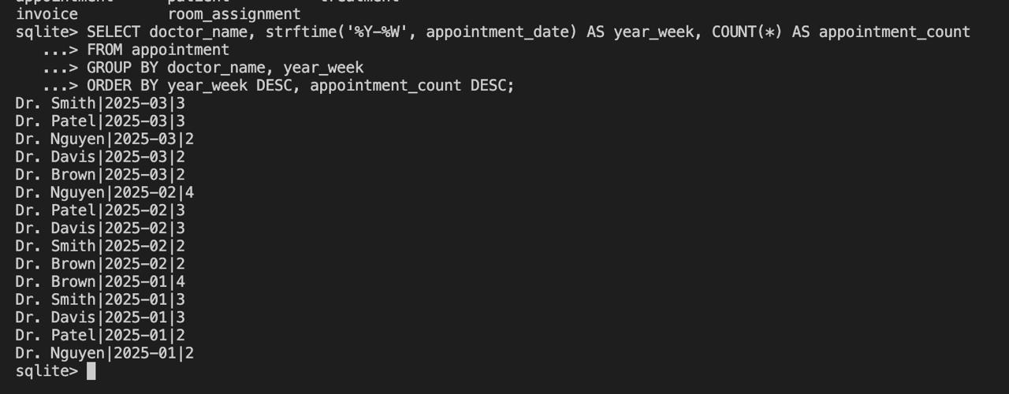
Analytics Overview
Number of appointments per doctor per week

Slide 8
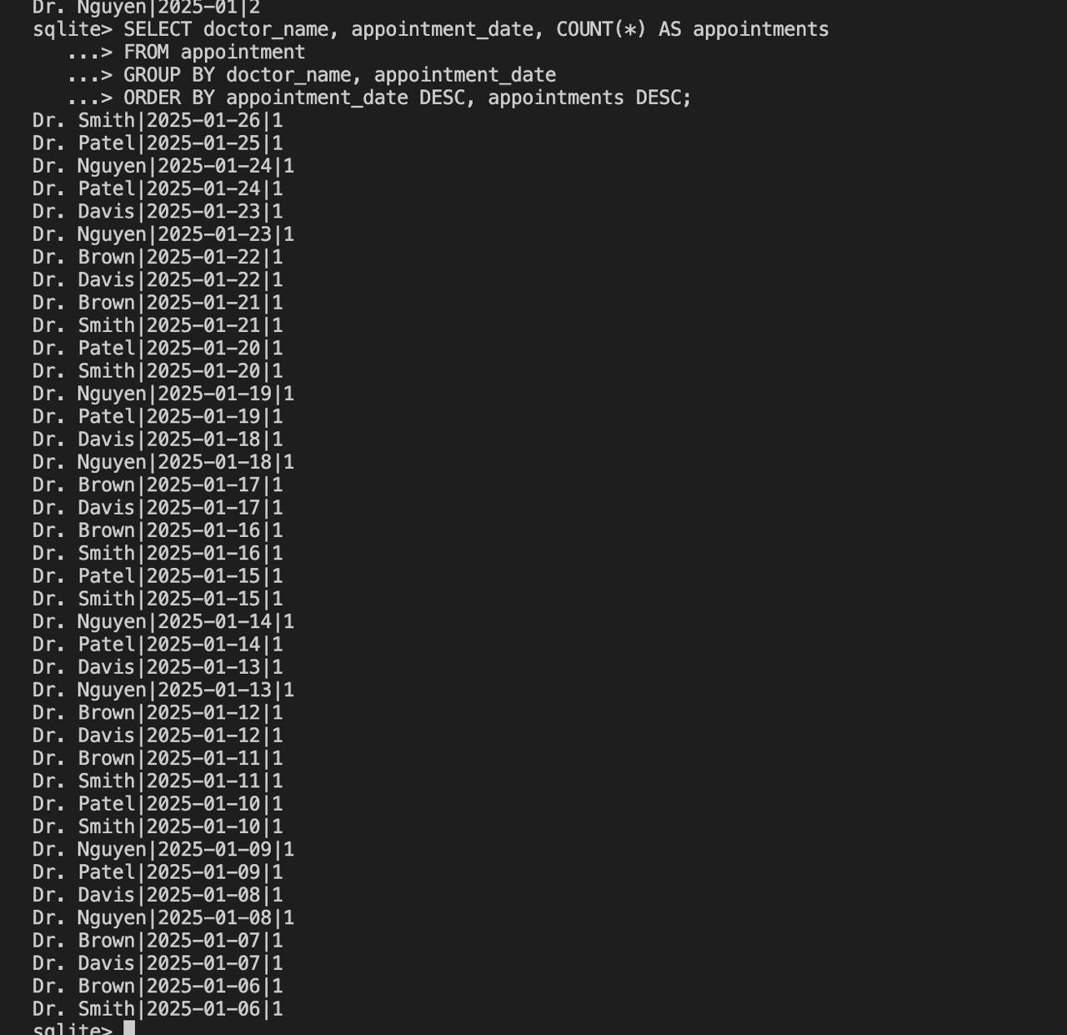
Analytics Overview
Doctor workload summary (appointments per day)

Slide 9
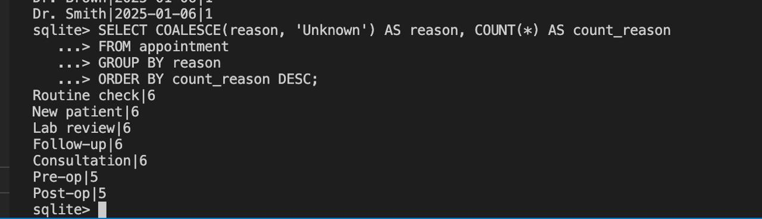
Analytics Overview
Most common visit reasons

Slide 10
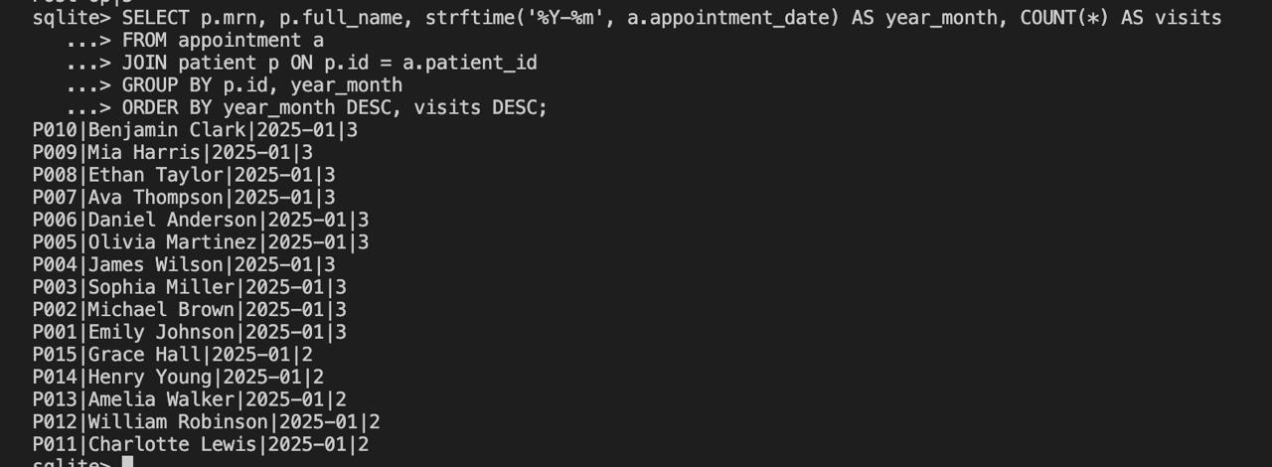
Analytics Overview
Patient visit frequency by month

Slide 11
Future Enhancements
Add a little bit of body textAdd role-based access so doctors, nurses, and admin each get their own login and dashboard
Build a dedicated doctor view to see appointments, patients, and room assignments
Expand analytics with charts for revenue, patient visits, and doctor workload
Improve UI design with a more modern layout and responsive components
Move from SQLite to MySQL/PostgreSQL for multi-user access and larger datasets
Add automated reminders for appointments and billing updates
Include complete medical history and treatment records for each patient
Deploy on the cloud for remote access and scalability

Slide 12

Key Learnings
Throughout the project, We gained valuable insights into database modeling, GUI design, and analytics implementation. Understanding the importance of effective validation and debugging processes has significantly enhanced my skills, ensuring a robust hospital management system that meets user needs efficiently.

Slide 13

Conclusion & Future
In summary, our hospital management system has achieved significant milestones in streamlining operations and enhancing data accessibility. With a focus on extensibility and user-centric design, we are well-prepared to adapt to future healthcare challenges and innovations.

